Slide 1
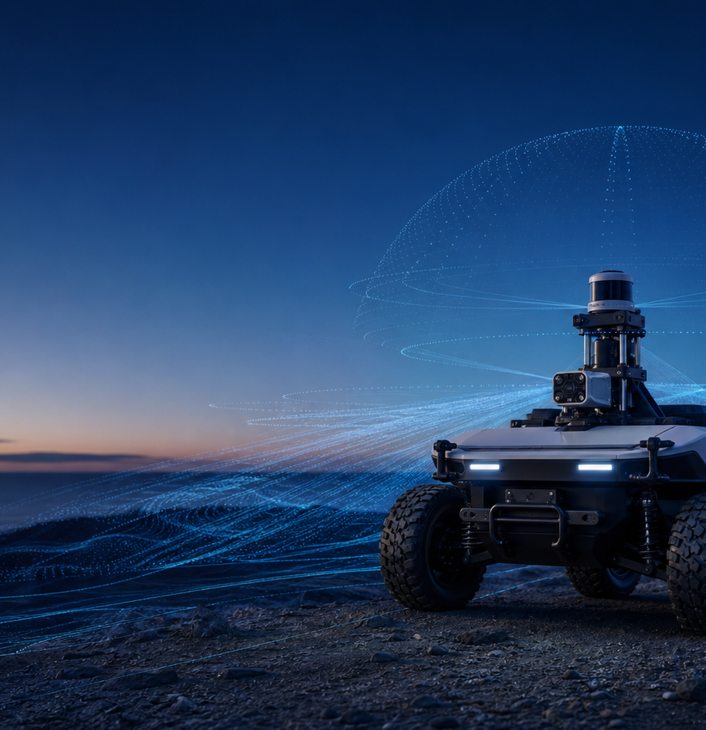
CISC 647
ROS 2 Systems
Inspection
LECTURE 1
Graph discovery, bag replay, and evidence-driven debugging
August 27, 2026
Notes:
Open with one question: how can we infer the structure and behavior of a distributed robotic system without reading its source code? Establish that the session is primarily laboratory investigation.
[Sources]
- /media/william/blueicedrive/Github/Intro2AV-CourseContent/2026/Documents/Syllabus.docx
- /media/william/blueicedrive/Github/Intro2AV-CourseContent/2026/Presentations/Lecture 8.pptx
- OpenAI ImageGen: autonomous research vehicle hero image

Slide 2
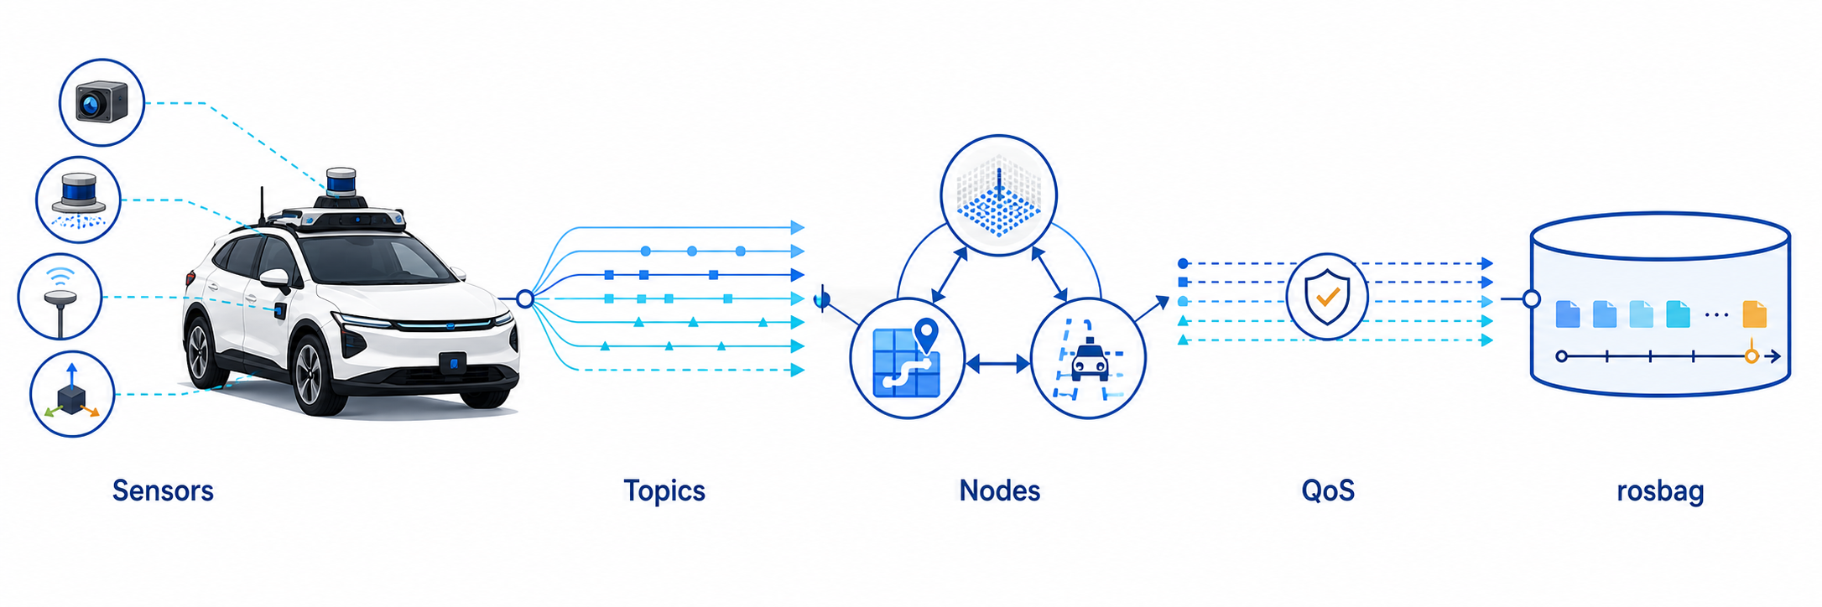
ROS 2 as a computational graph
Notes:
Use the visual to establish the analytical model: sensors publish typed streams, nodes consume or transform them, QoS governs endpoint compatibility, and rosbag records or replays the traffic.
[Sources]
- https://docs.ros.org/en/humble/Concepts/Basic/Interfaces-Topics-Services-Actions.html
- https://docs.ros.org/en/humble/Concepts/Intermediate/About-Quality-of-Service-Settings.html
- https://docs.ros.org/en/humble/Tutorials/Beginner-CLI-Tools/Recording-And-Playing-Back-Data/Recording-And-Playing-Back-Data.html
- OpenAI ImageGen: ROS 2 sensor-to-bag computational graph

Slide 3
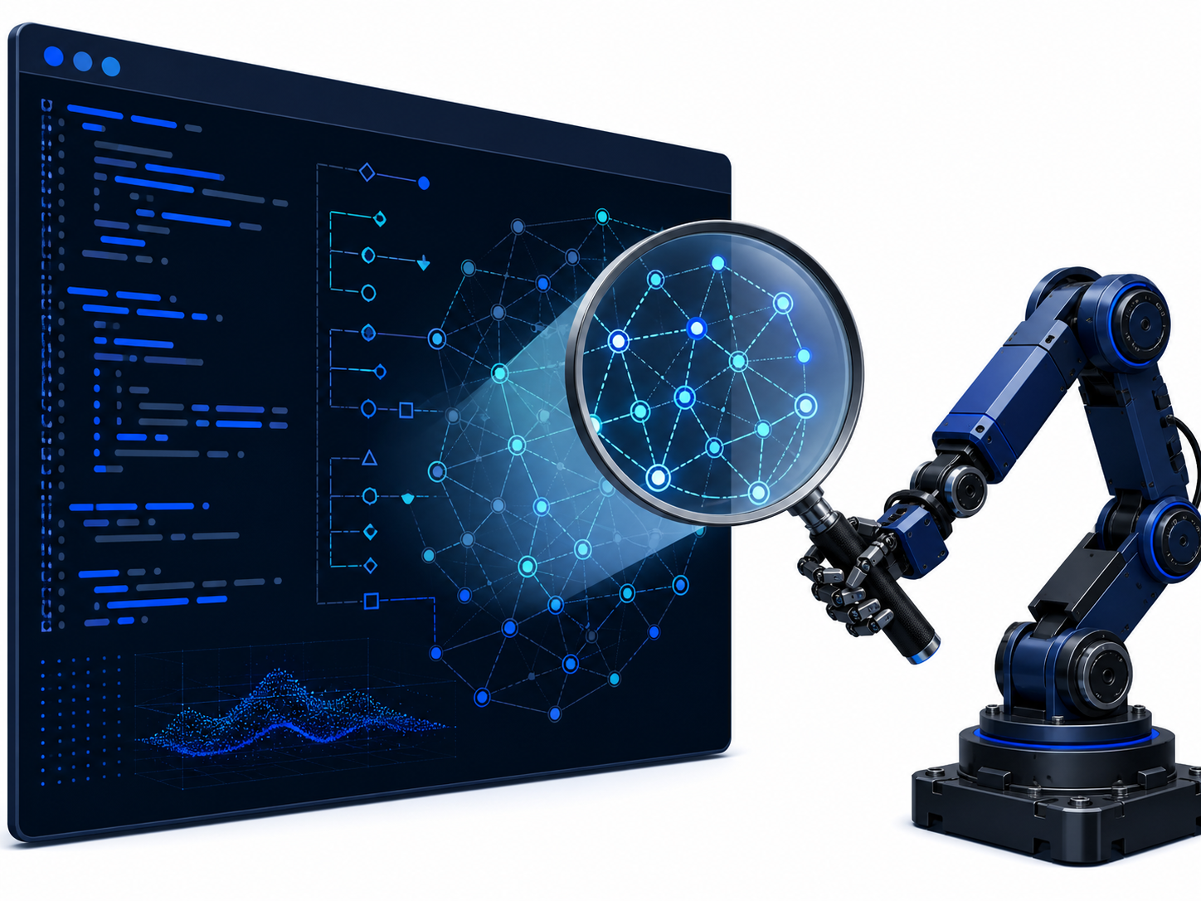
Core entities and communication contracts
Node runtime process with a scoped responsibility
Topic named channel for continuous data
Message typed payload carried by a topic
QoS endpoint compatibility and delivery policy
Notes:
Limit exposition to the four entities needed for the lab. Ask students to instantiate each term using a camera driver and image stream. Defer services and actions.
[Sources]
- https://docs.ros.org/en/humble/Tutorials/Beginner-CLI-Tools/Understanding-ROS2-Nodes/Understanding-ROS2-Nodes.html
- https://docs.ros.org/en/humble/Concepts/Basic/Interfaces-Topics-Services-Actions.html
- https://docs.ros.org/en/humble/Concepts/Intermediate/About-Quality-of-Service-Settings.html
- OpenAI ImageGen: technical ROS 2 entity and contract illustration

Slide 4
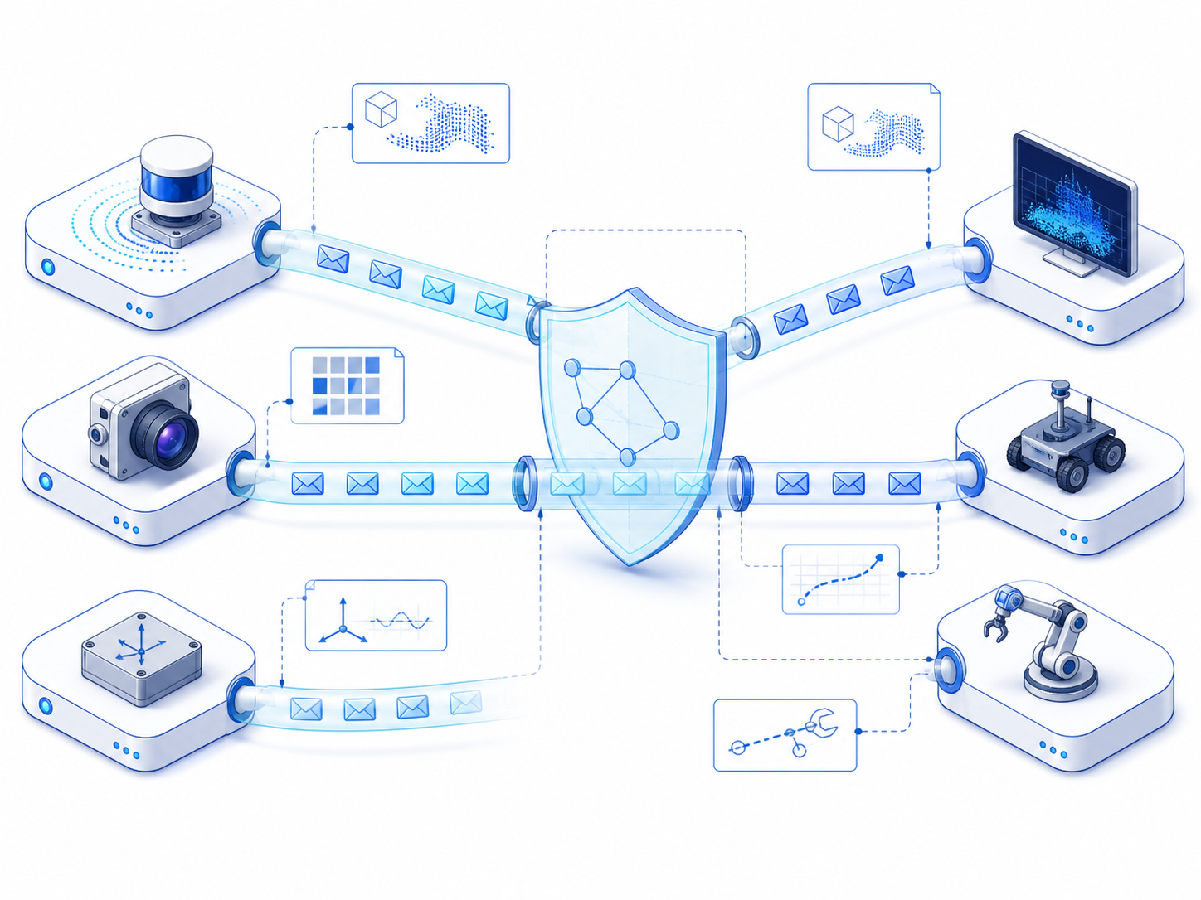
Essential introspection commands
ros2 node list
Enumerate runtime participants
ros2 topic list -t
Enumerate streams and types
ros2 topic info -v <topic>
Inspect endpoints and QoS
ros2 topic echo <topic> --once
Sample one message
ros2 topic hz / bw <topic>
Measure rate and throughput
ros2 bag info . / play .
Inspect and replay a recording
Notes:
Demonstrate the recurring command grammar and ros2 <verb> --help. Students will use these commands repeatedly; avoid exhaustively teaching options.
[Sources]
- https://docs.ros.org/en/humble/Tutorials/Beginner-CLI-Tools/Understanding-ROS2-Nodes/Understanding-ROS2-Nodes.html
- https://docs.ros.org/en/humble/Concepts/Basic/Interfaces-Topics-Services-Actions.html
- https://docs.ros.org/en/humble/Tutorials/Beginner-CLI-Tools/Recording-And-Playing-Back-Data/Recording-And-Playing-Back-Data.html
- OpenAI ImageGen: terminal introspection illustration

Slide 5
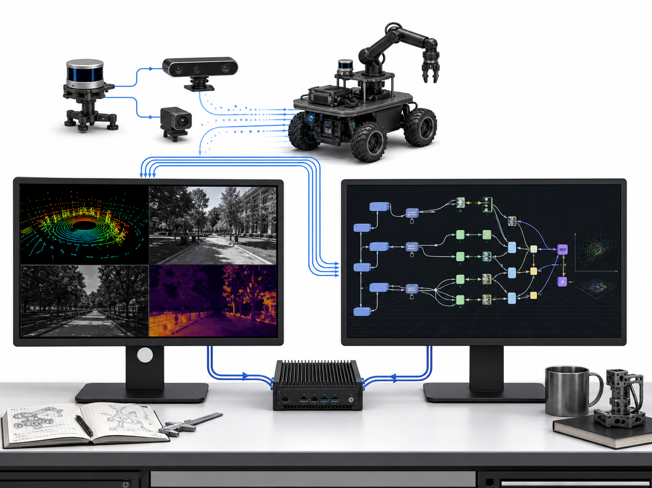
Laboratory execution model
Terminal A
ros2 bag play . --loop
Terminal B
ros2 node list
ros2 topic list -t
Source the ROS 2 environment in every new shell.
Work in pairs; exchange playback and analysis roles midway.
Notes:
Rosbag playback creates runtime publishers from recorded data. Pair work reduces setup friction while still requiring each student to operate both terminals.
[Sources]
- https://docs.ros.org/en/humble/Tutorials/Beginner-CLI-Tools/Recording-And-Playing-Back-Data/Recording-And-Playing-Back-Data.html
- https://docs.ros.org/en/humble/Tutorials/Beginner-CLI-Tools/Understanding-ROS2-Nodes/Understanding-ROS2-Nodes.html
- OpenAI ImageGen: dual-terminal robotics laboratory

Slide 6
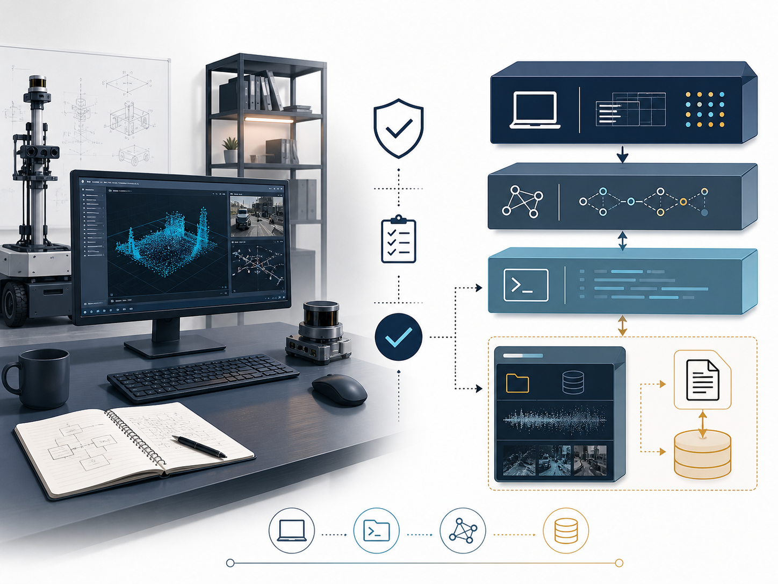
Environment and dataset verification
Download the course rosbag
echo $ROS_DISTRO
Windows cmd: echo %ROS_DISTRO%
ros2 bag --help
Verify the rosbag plugin
metadata.yaml + *.db3
Run commands from the inner bag directory
Use the course Ubuntu VM when native support blocks RViz.
Notes:
Pause until every pair can identify its active distribution, run ros2 bag --help, and locate both bag files. PowerShell uses $env:ROS_DISTRO. There is no official Krystal release; Crystal Clemmys is EOL, while Kilted Kaiju is current in the release family. Use the supported course environment if compatibility becomes the exercise rather than the data.
[Sources]
- https://drive.google.com/file/d/1zd5GGe6t-UIEEMK9XJ1UCwRFa9NWEHrm/view?usp=sharing
- https://docs.ros.org/en/rolling/Releases.html
- /media/william/blueicedrive/Github/Intro2AV-CourseContent/2026/Data/Project1/project1_simulated_data/metadata.yaml
- OpenAI ImageGen: environment and dataset verification illustration

Slide 7
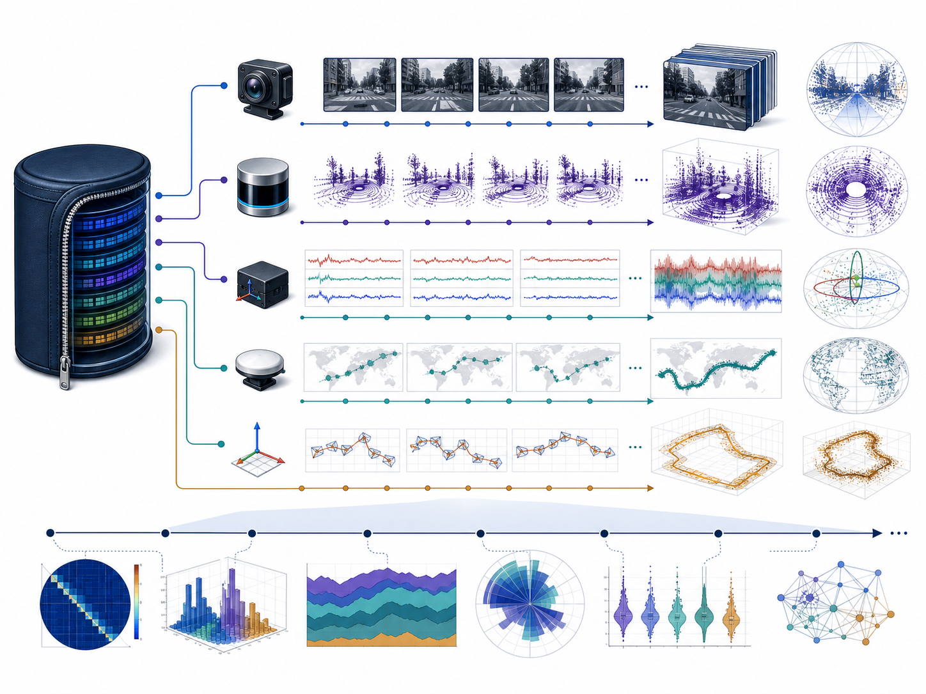
Exercise 1: characterize the recording
ros2 bag info .
Determine storage, duration, and total message count.
Identify every topic and message type.
Predict the dominant bandwidth contributors before playback.
Record the assumptions behind the prediction.
Notes:
Expected evidence: SQLite3, 42.379 seconds, 6,589 messages, and five streams. Camera has 419 Image messages; LiDAR has 475 PointCloud2 messages; IMU has 1,897; GNSS fix and pose have 1,899 each. Ask why message count alone does not determine bandwidth.
[Sources]
- https://docs.ros.org/en/humble/Tutorials/Beginner-CLI-Tools/Recording-And-Playing-Back-Data/Recording-And-Playing-Back-Data.html
- /media/william/blueicedrive/Github/Intro2AV-CourseContent/2026/Data/Project1/project1_simulated_data/metadata.yaml
- OpenAI ImageGen: five-stream rosbag characterization illustration

Slide 8
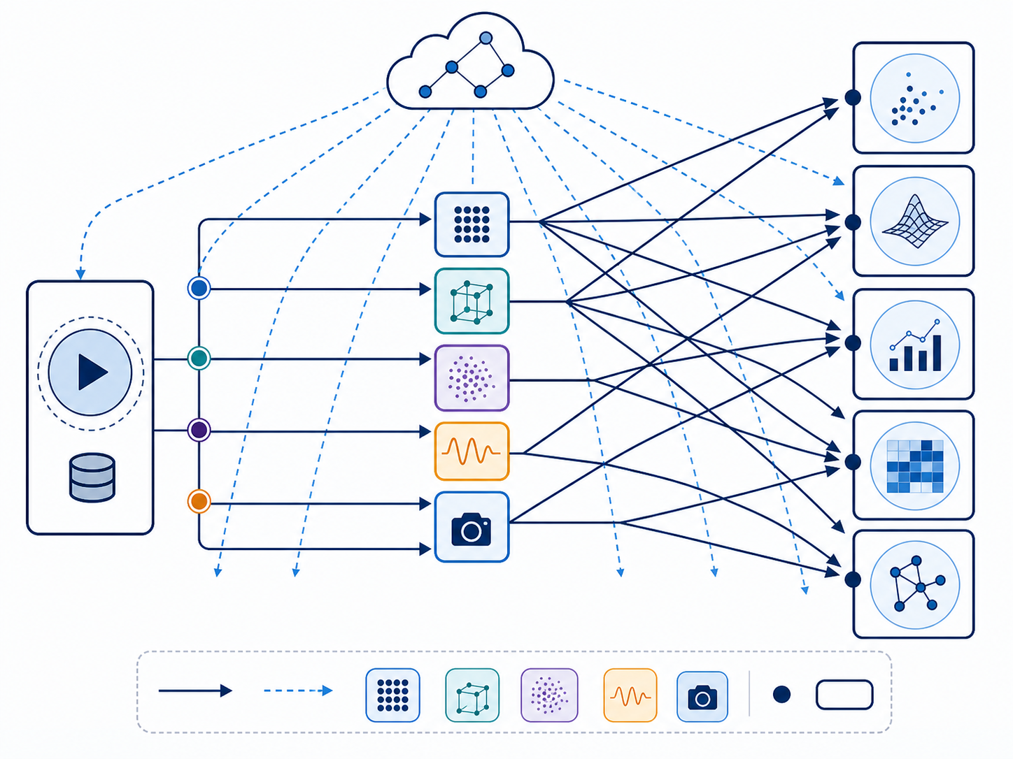
Exercise 2: reconstruct the runtime graph
ros2 bag play . --loop
Terminal A
ros2 node list
Terminal B
ros2 topic list -t
Terminal B
Draw the observed publication relationships.
Separate stored metadata from runtime discovery evidence.
Notes:
Students should discover /rosbag2_player and the five recorded topics. The analytical distinction is important: bag info reads a file; node and topic commands interrogate the active DDS graph.
[Sources]
- https://docs.ros.org/en/humble/Tutorials/Beginner-CLI-Tools/Understanding-ROS2-Nodes/Understanding-ROS2-Nodes.html
- https://docs.ros.org/en/humble/Tutorials/Beginner-CLI-Tools/Recording-And-Playing-Back-Data/Recording-And-Playing-Back-Data.html
- /media/william/blueicedrive/Github/Intro2AV-CourseContent/2026/Data/Project1/project1_simulated_data/metadata.yaml
- OpenAI ImageGen: runtime graph reconstruction illustration

Slide 9
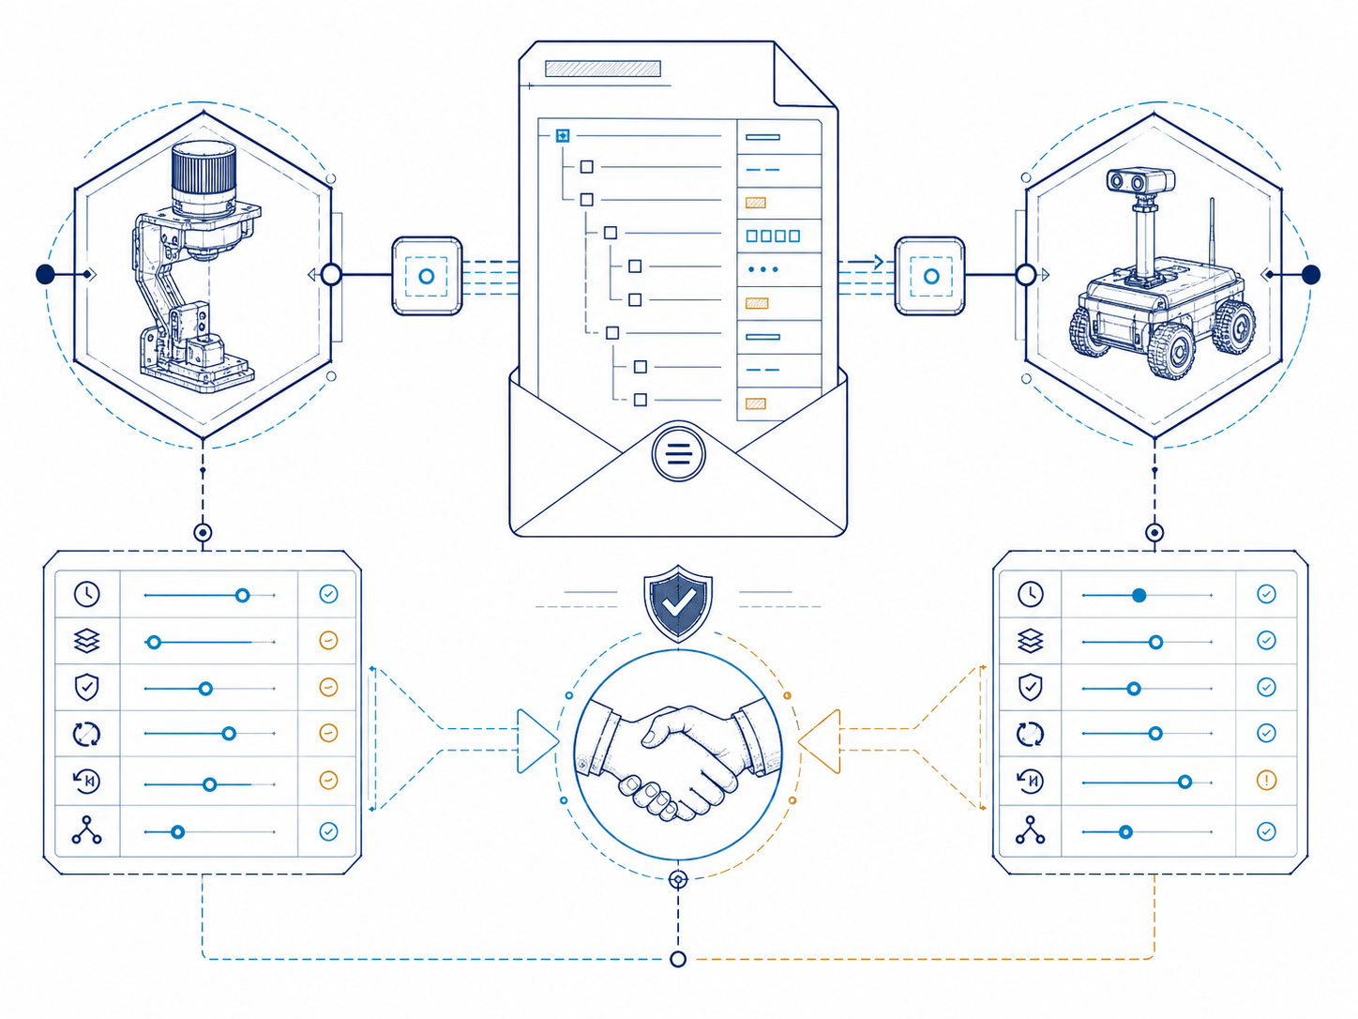
Exercise 3: inspect topic contracts
ros2 topic type <topic>
ros2 interface show <message_type>
ros2 topic info -v <topic>
Compare one camera stream with one LiDAR stream.
Record type, publisher, reliability, and durability.
Notes:
Require students to select topics from their own discovery output. They should distinguish Image from PointCloud2 and identify the rosbag player as publisher. The validated Humble host offered BEST_EFFORT and VOLATILE for the camera endpoint.
[Sources]
- https://docs.ros.org/en/humble/Concepts/Basic/Interfaces-Topics-Services-Actions.html
- https://docs.ros.org/en/humble/Concepts/Intermediate/About-Quality-of-Service-Settings.html
- /media/william/blueicedrive/Github/Intro2AV-CourseContent/2026/Data/Project1/project1_simulated_data/metadata.yaml
- OpenAI ImageGen: typed topic contract illustration

Slide 10
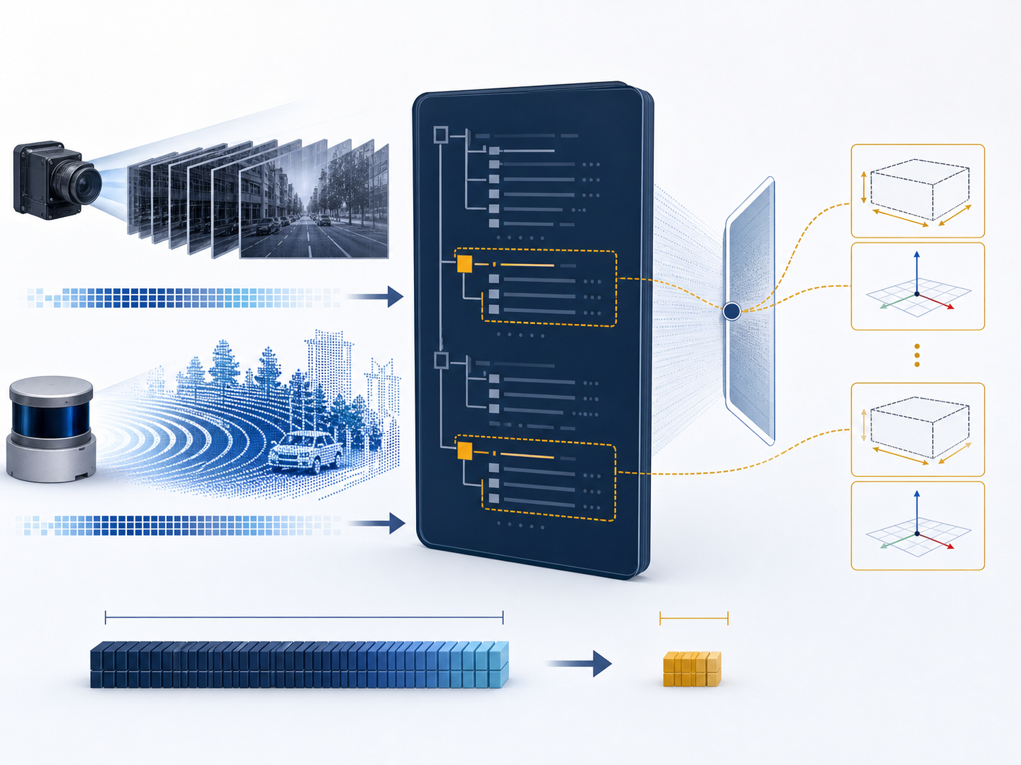
Exercise 4: extract targeted fields
ros2 topic echo <topic> --once
--field <field>
Camera: determine width and height.
LiDAR: determine frame_id and point count proxy.
Explain why full-message output is a weak diagnostic.
Compare results with another pair.
Notes:
Expected values: camera width 800 and height 600; LiDAR frame velodyne_top_base_link; sampled cloud width approximately 33,111. Point count varies by message. Emphasize precise field queries over dumping binary arrays.
[Sources]
- /media/william/blueicedrive/Github/Intro2AV-CourseContent/2026/Data/Project1/project1_simulated_data/metadata.yaml
- https://docs.ros.org/en/humble/Concepts/Basic/Interfaces-Topics-Services-Actions.html
- OpenAI ImageGen: targeted message-field extraction illustration

Slide 11
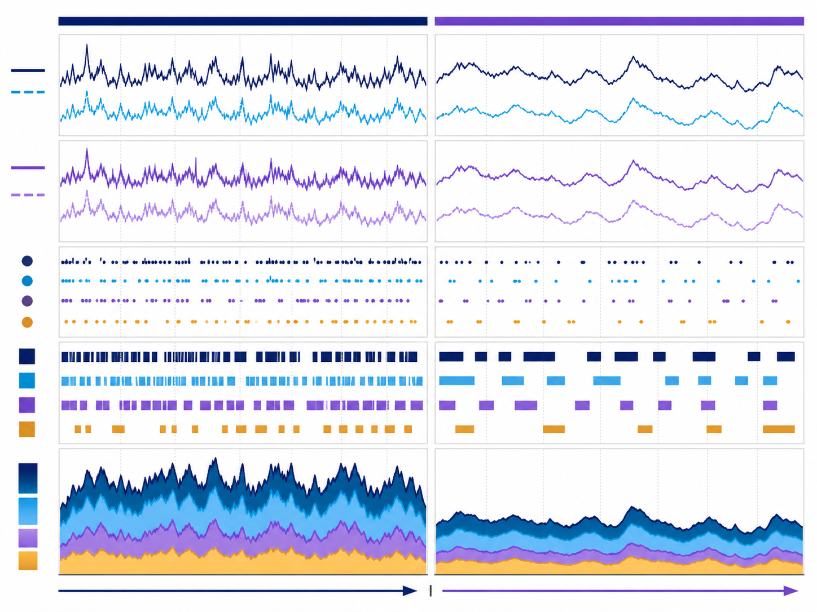
Exercise 5: quantify runtime behavior
ros2 topic hz <topic>
ros2 topic bw <topic>
Measure camera and LiDAR at 1.0× playback.
Predict both measurements at 0.5× playback.
Test the prediction and quantify the deviation.
Notes:
Metadata implies approximately 9.9 Hz for camera and 11.2 Hz for LiDAR at 1.0x. A validated camera sample is roughly 1.92 MB per message. Results vary with CPU, discovery, QoS, and measurement window; at 0.5x, rate and throughput should approximately halve.
[Sources]
- /media/william/blueicedrive/Github/Intro2AV-CourseContent/2026/Data/Project1/project1_simulated_data/metadata.yaml
- https://docs.ros.org/en/humble/Concepts/Intermediate/About-Quality-of-Service-Settings.html
- OpenAI ImageGen: scientific rate and bandwidth comparison

Slide 12
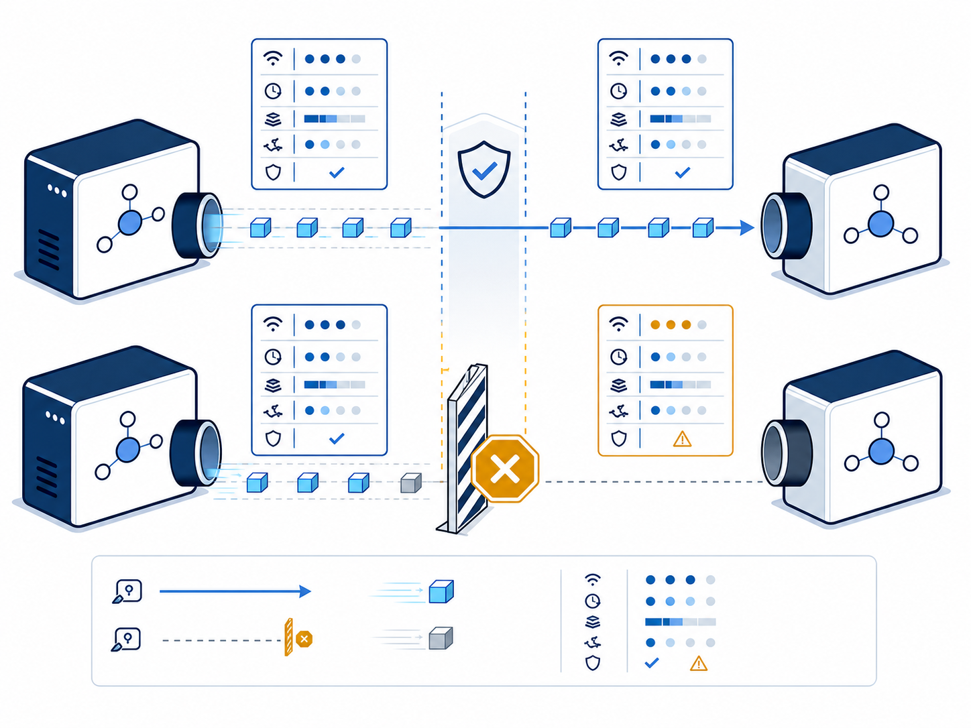
Exercise 6: test QoS compatibility
ros2 topic info -v <camera_topic>
ros2 topic echo <camera_topic> --once
... --qos-reliability best_effort
Construct a compatible and an incompatible request.
Explain why discovery can succeed while delivery fails.
Notes:
If the CLI automatically selects a compatible sensor-data profile, use RViz reliability settings or an explicitly reliable subscription to create the mismatch. The objective is to separate graph discovery from endpoint compatibility.
[Sources]
- https://docs.ros.org/en/humble/Concepts/Intermediate/About-Quality-of-Service-Settings.html
- /media/william/blueicedrive/Github/Intro2AV-CourseContent/2026/Data/Project1/project1_simulated_data/metadata.yaml
- OpenAI ImageGen: QoS compatibility boundary illustration

Slide 13
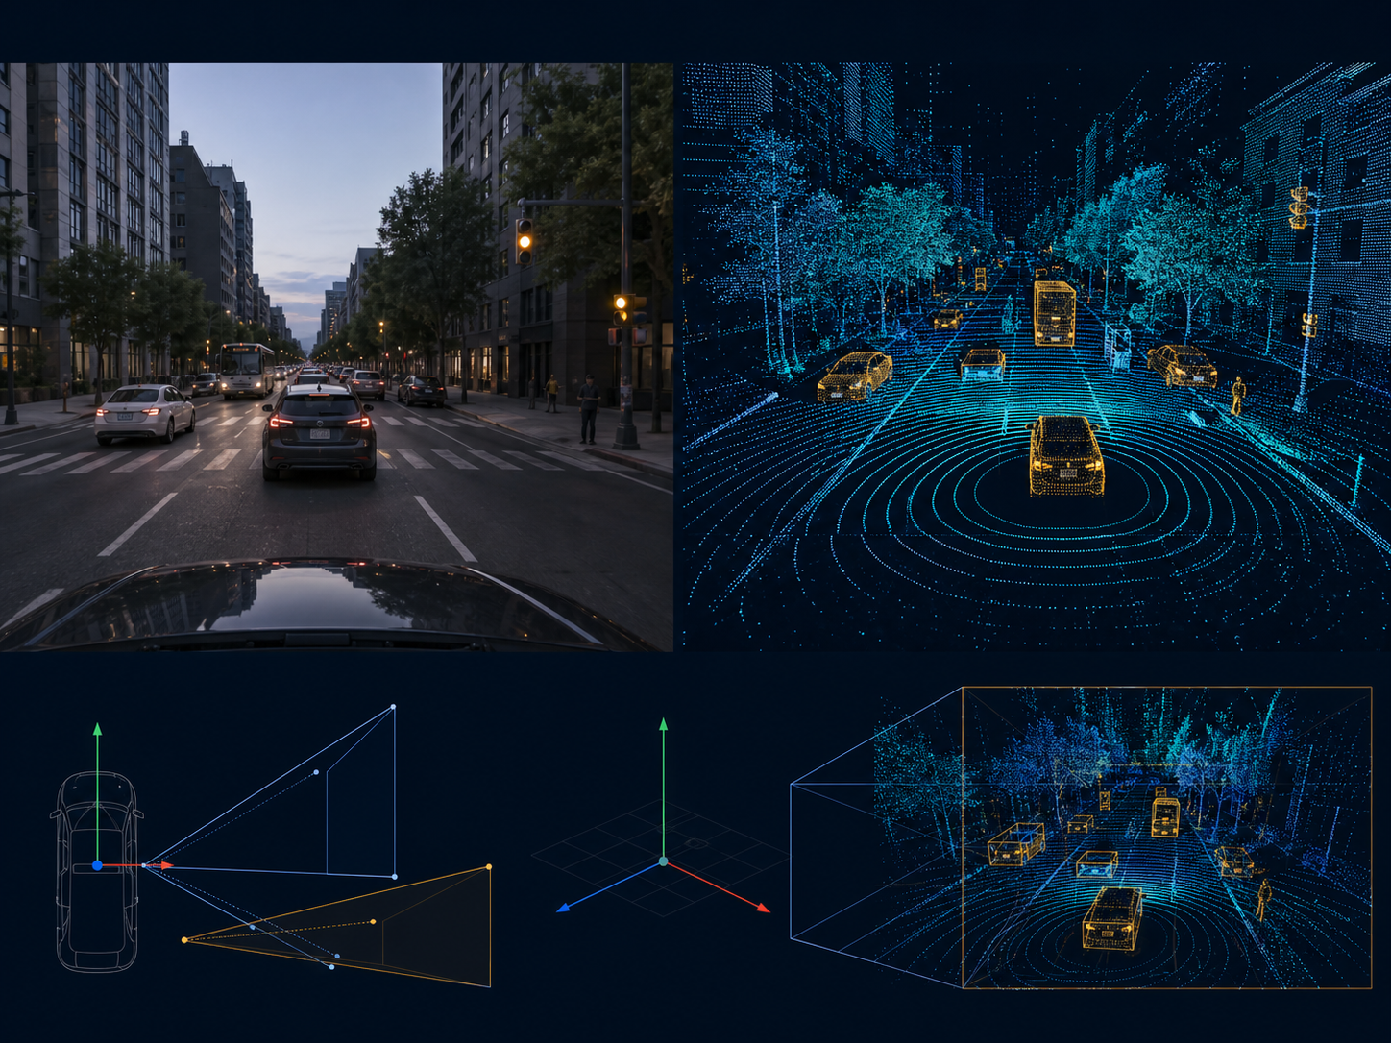
Exercise 7: validate spatial data in RViz
rviz2
Add the camera Image stream; verify reliability.
Add the LiDAR PointCloud2 stream.
Set the fixed frame from the message header.
Capture one view containing both modalities.
Notes:
Students configure RViz from their own discovered topics. If camera is blank, inspect reliability. If the cloud reports a transform error, set the fixed frame to velodyne_top_base_link. Use the course Ubuntu VM when native macOS or Windows visualization is blocked.
[Sources]
- https://docs.ros.org/en/humble/Concepts/Intermediate/About-Quality-of-Service-Settings.html
- /media/william/blueicedrive/Github/Intro2AV-CourseContent/2026/Data/Project1/project1_simulated_data/metadata.yaml
- OpenAI ImageGen: camera and LiDAR spatial validation scene

Slide 14
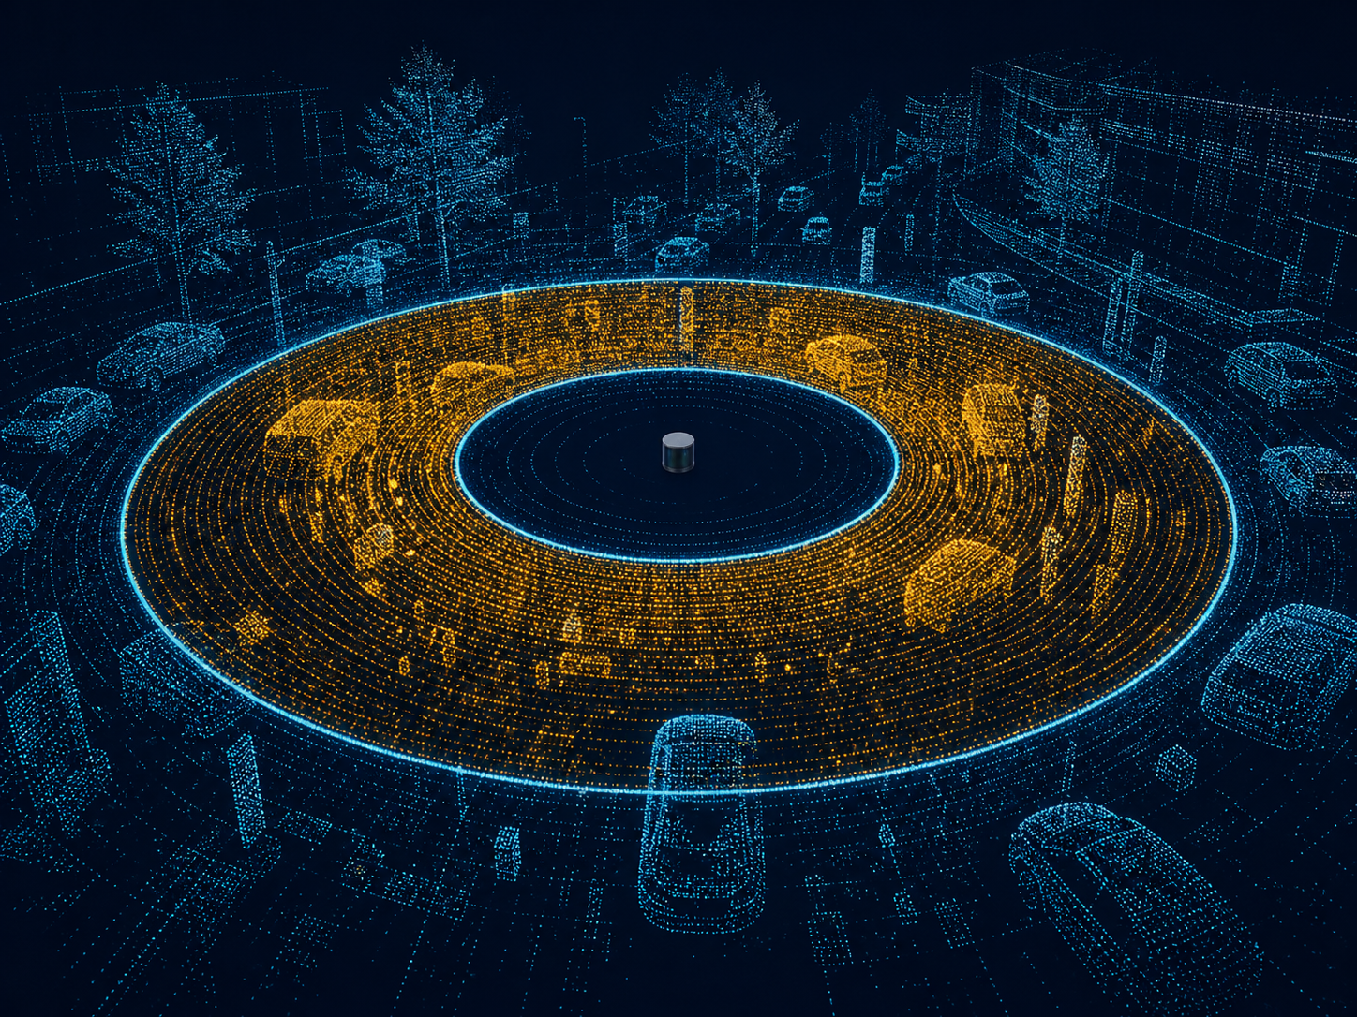
Synthesis: design a range-filtering subscriber
Input sensor_msgs/msg/PointCloud2
Filter retain points with 10 ≤ ‖p‖ ≤ 50 m
Output preserve frame and timestamp semantics
QoS select a policy compatible with the source
Validation counts, throughput, and RViz evidence
Notes:
Give pairs 15–20 minutes. Require a defensible dataflow and test plan, not implementation unless time permits. Strong answers parse PointCloud2 fields, compute Euclidean radius, preserve the header, select sensor-data QoS, and validate with message counts plus RViz.
[Sources]
- https://docs.ros.org/en/humble/Concepts/Basic/Interfaces-Topics-Services-Actions.html
- https://docs.ros.org/en/humble/Concepts/Intermediate/About-Quality-of-Service-Settings.html
- /media/william/blueicedrive/Github/Intro2AV-CourseContent/2026/Data/Project1/project1_simulated_data/metadata.yaml
- OpenAI ImageGen: LiDAR annular range-filter visualization

Slide 15
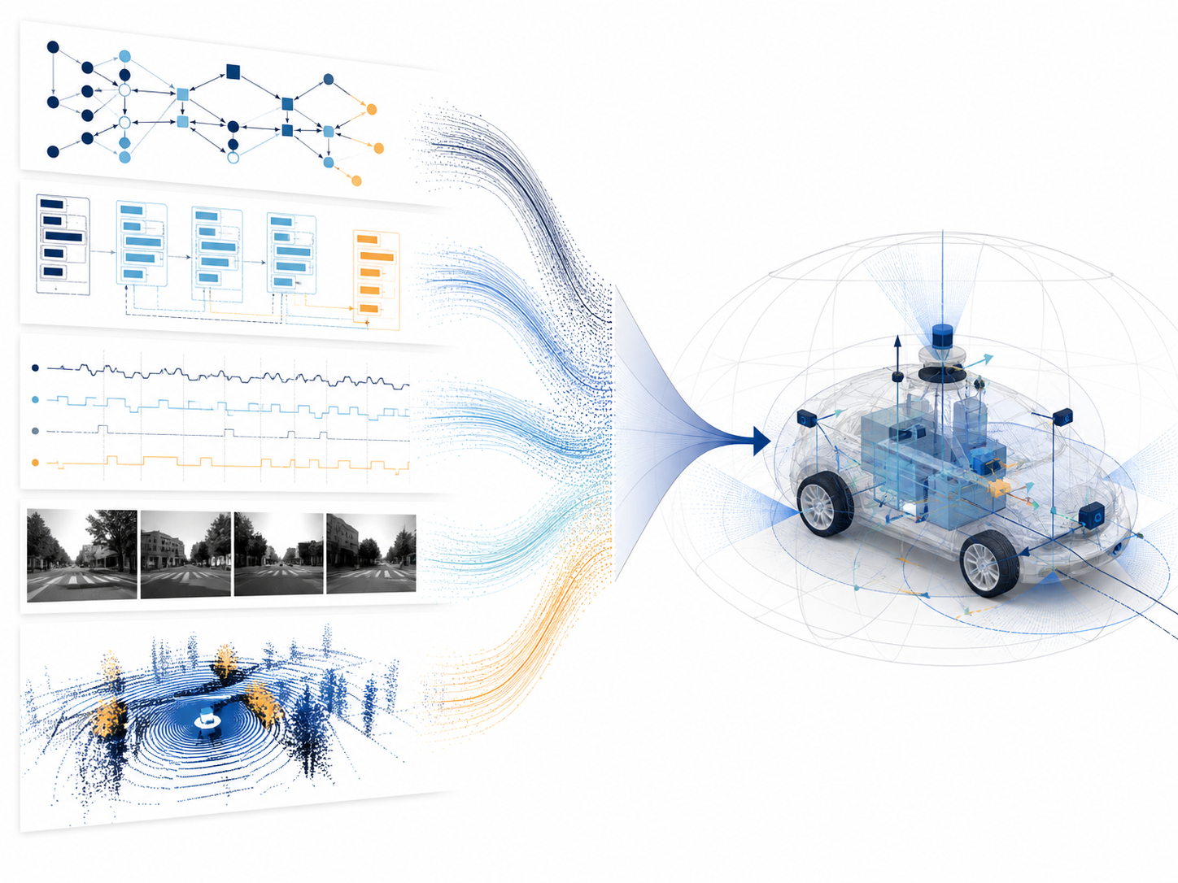
Technical debrief
Graph publishers, subscribers, and streams
Contract message type and QoS
Behavior measured rate and throughput
Spatial validity frame and display configuration
When data disappears, which command should run first—and why?
Notes:
Collect one evidence-backed answer for each category. Close on the idea that ROS 2 debugging is systematic boundary testing: environment, graph discovery, message contract, observed behavior, then visualization.
[Sources]
- https://docs.ros.org/en/humble/Tutorials/Beginner-CLI-Tools/Understanding-ROS2-Nodes/Understanding-ROS2-Nodes.html
- https://docs.ros.org/en/humble/Concepts/Intermediate/About-Quality-of-Service-Settings.html
- https://docs.ros.org/en/humble/Tutorials/Beginner-CLI-Tools/Recording-And-Playing-Back-Data/Recording-And-Playing-Back-Data.html
- /media/william/blueicedrive/Github/Intro2AV-CourseContent/2026/Data/Project1/project1_simulated_data/metadata.yaml
- OpenAI ImageGen: evidence-synthesis engineering illustration

